Slide 1



Dzmitry Vincheuski
PTOP - 2019
Bociany na miejskim
wysypisku śmieci pod Grodna:
co już wiemy, a czego nie
APB-BirdLife Belarus, Hrodna

Slide 2
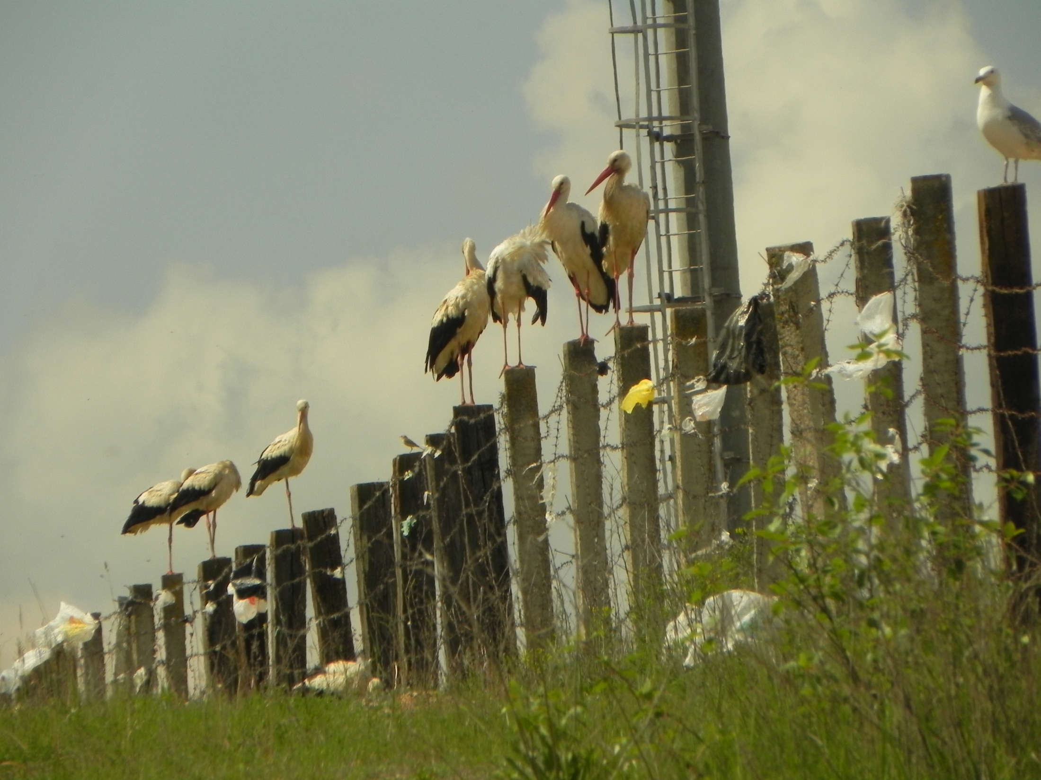

Since May 2016 we studying White storks at Hrodna city dump. We use different time of the day for the complete censuses of feeding and resting birds to compare activity and numbers. But since 2018 we use the same 17.00-19.00 periods almost every two weeks in the season.

Slide 3
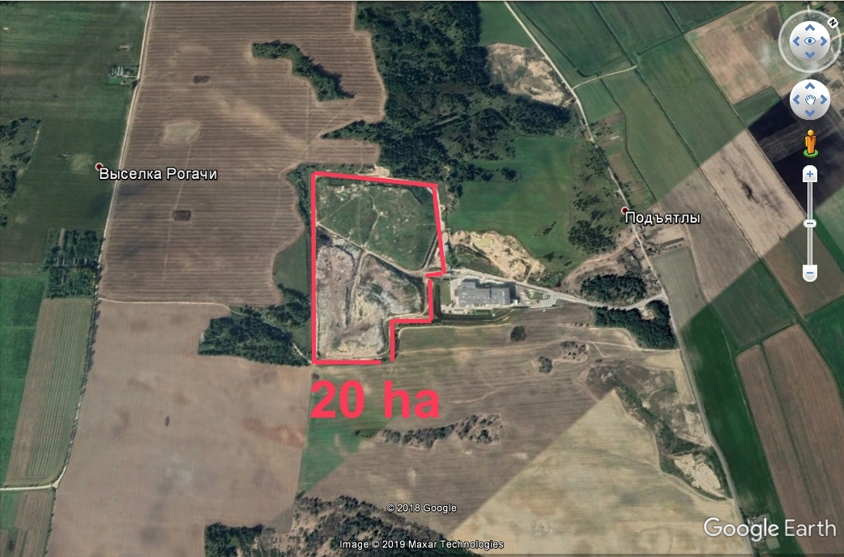

The study area was constant as well as census point on the highest hill just 15 m near the dump fence.

Slide 4
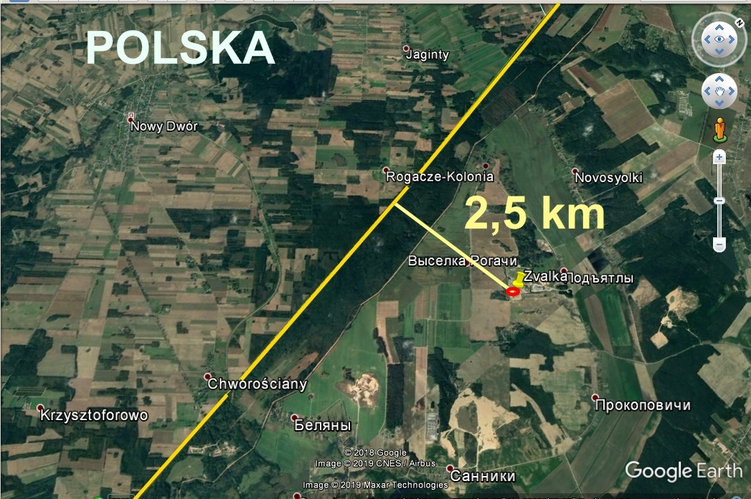
It is the dump for 375.000 citizens of Hrodna city with ca 12 trucks per hour with `fresh` stuff 7 days per week all year around.

Slide 5
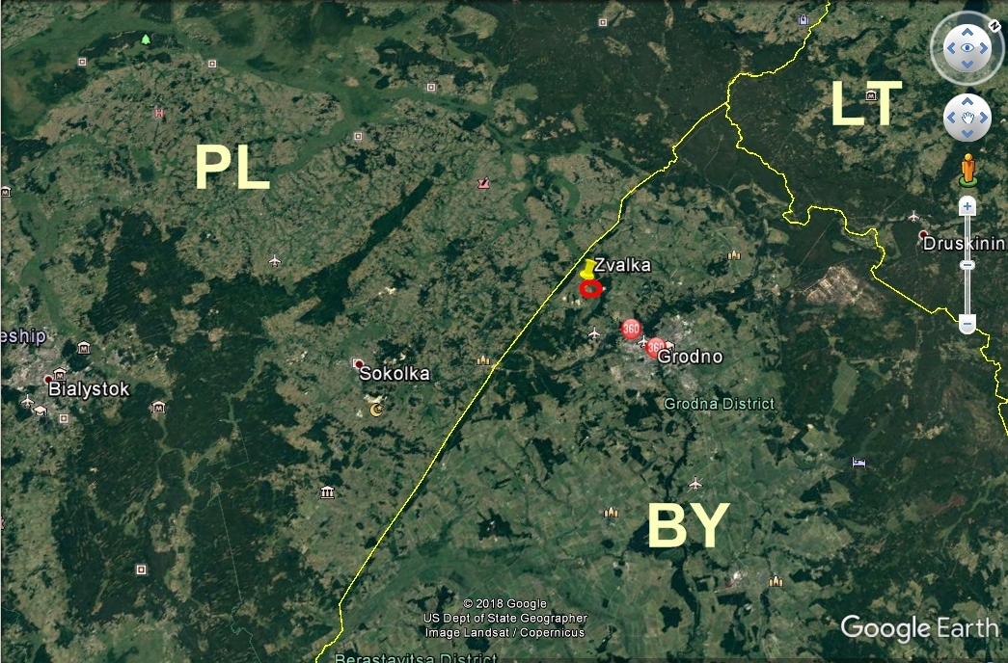
It is obvious that storks from Poland use it
as well as birds from Belarus!

Slide 6

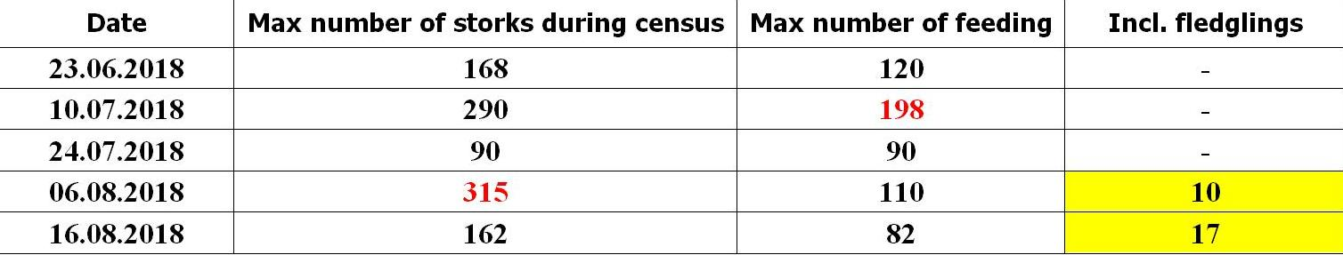
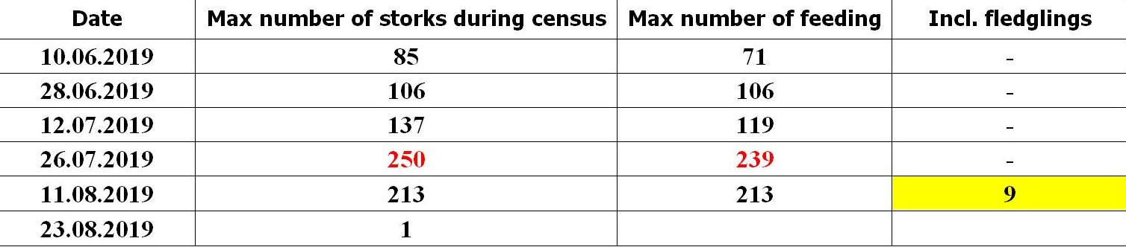
Preliminary results

Slide 7
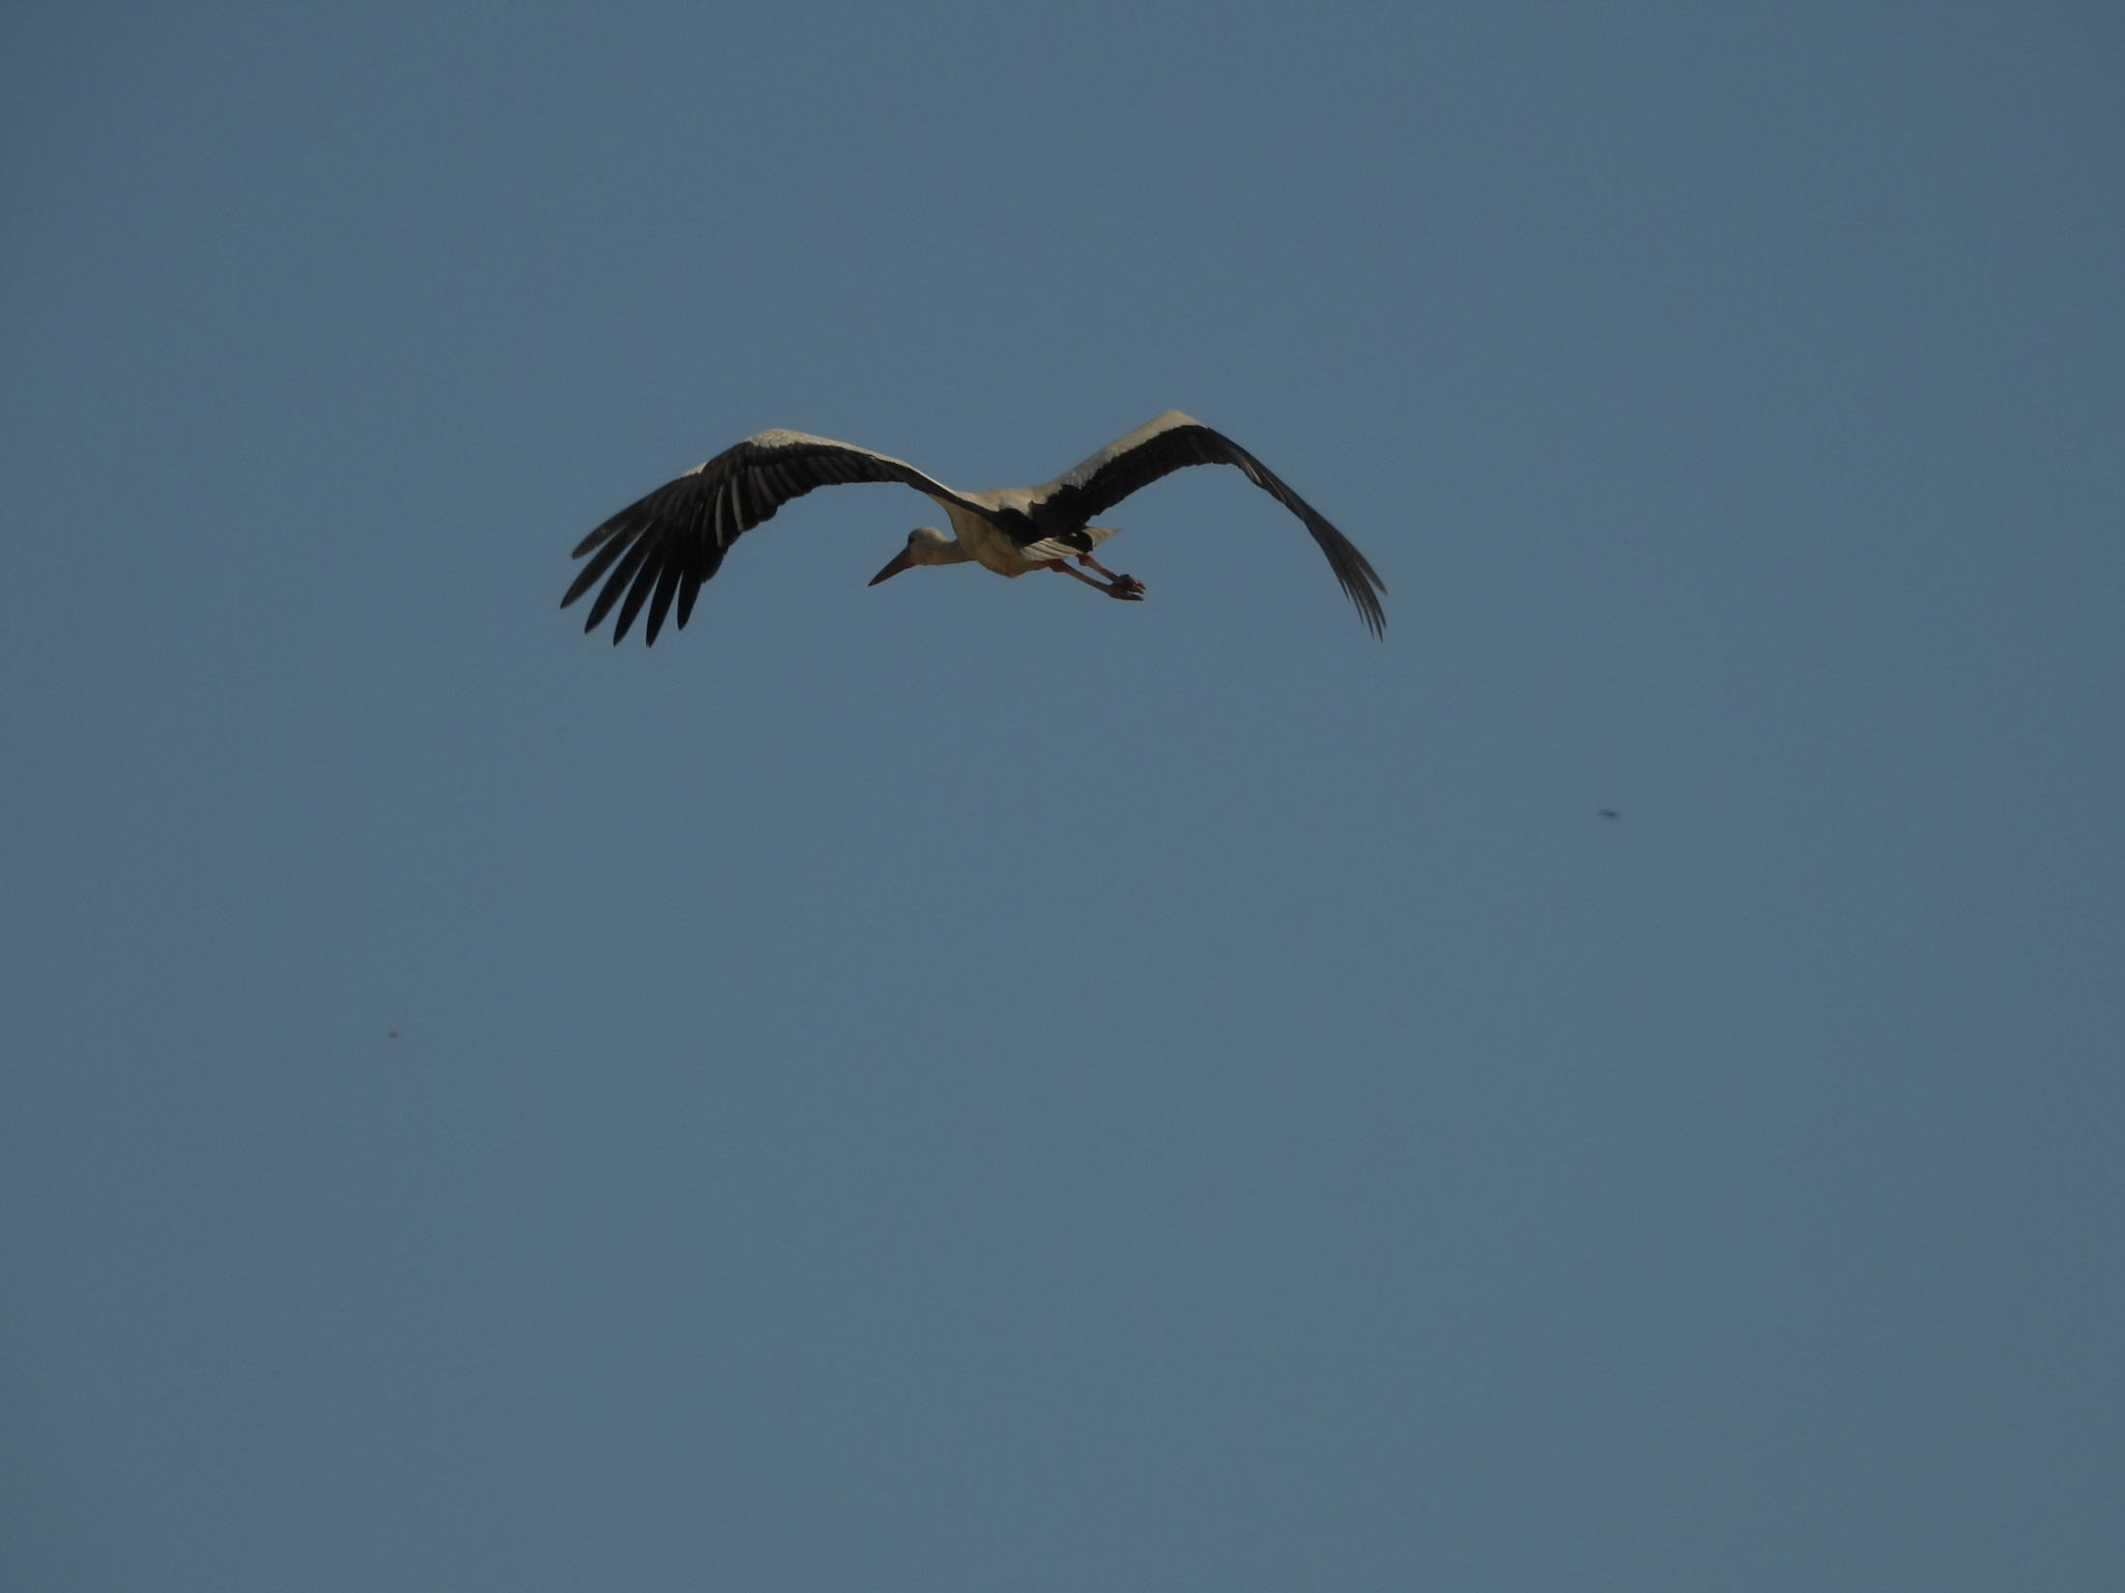

Most of the birds feeding and sleeping on the dump or just nearby.
They should be not nesting (young) birds.
Some birds that visiting dump are nesting birds and they fly there from far away.

Slide 8
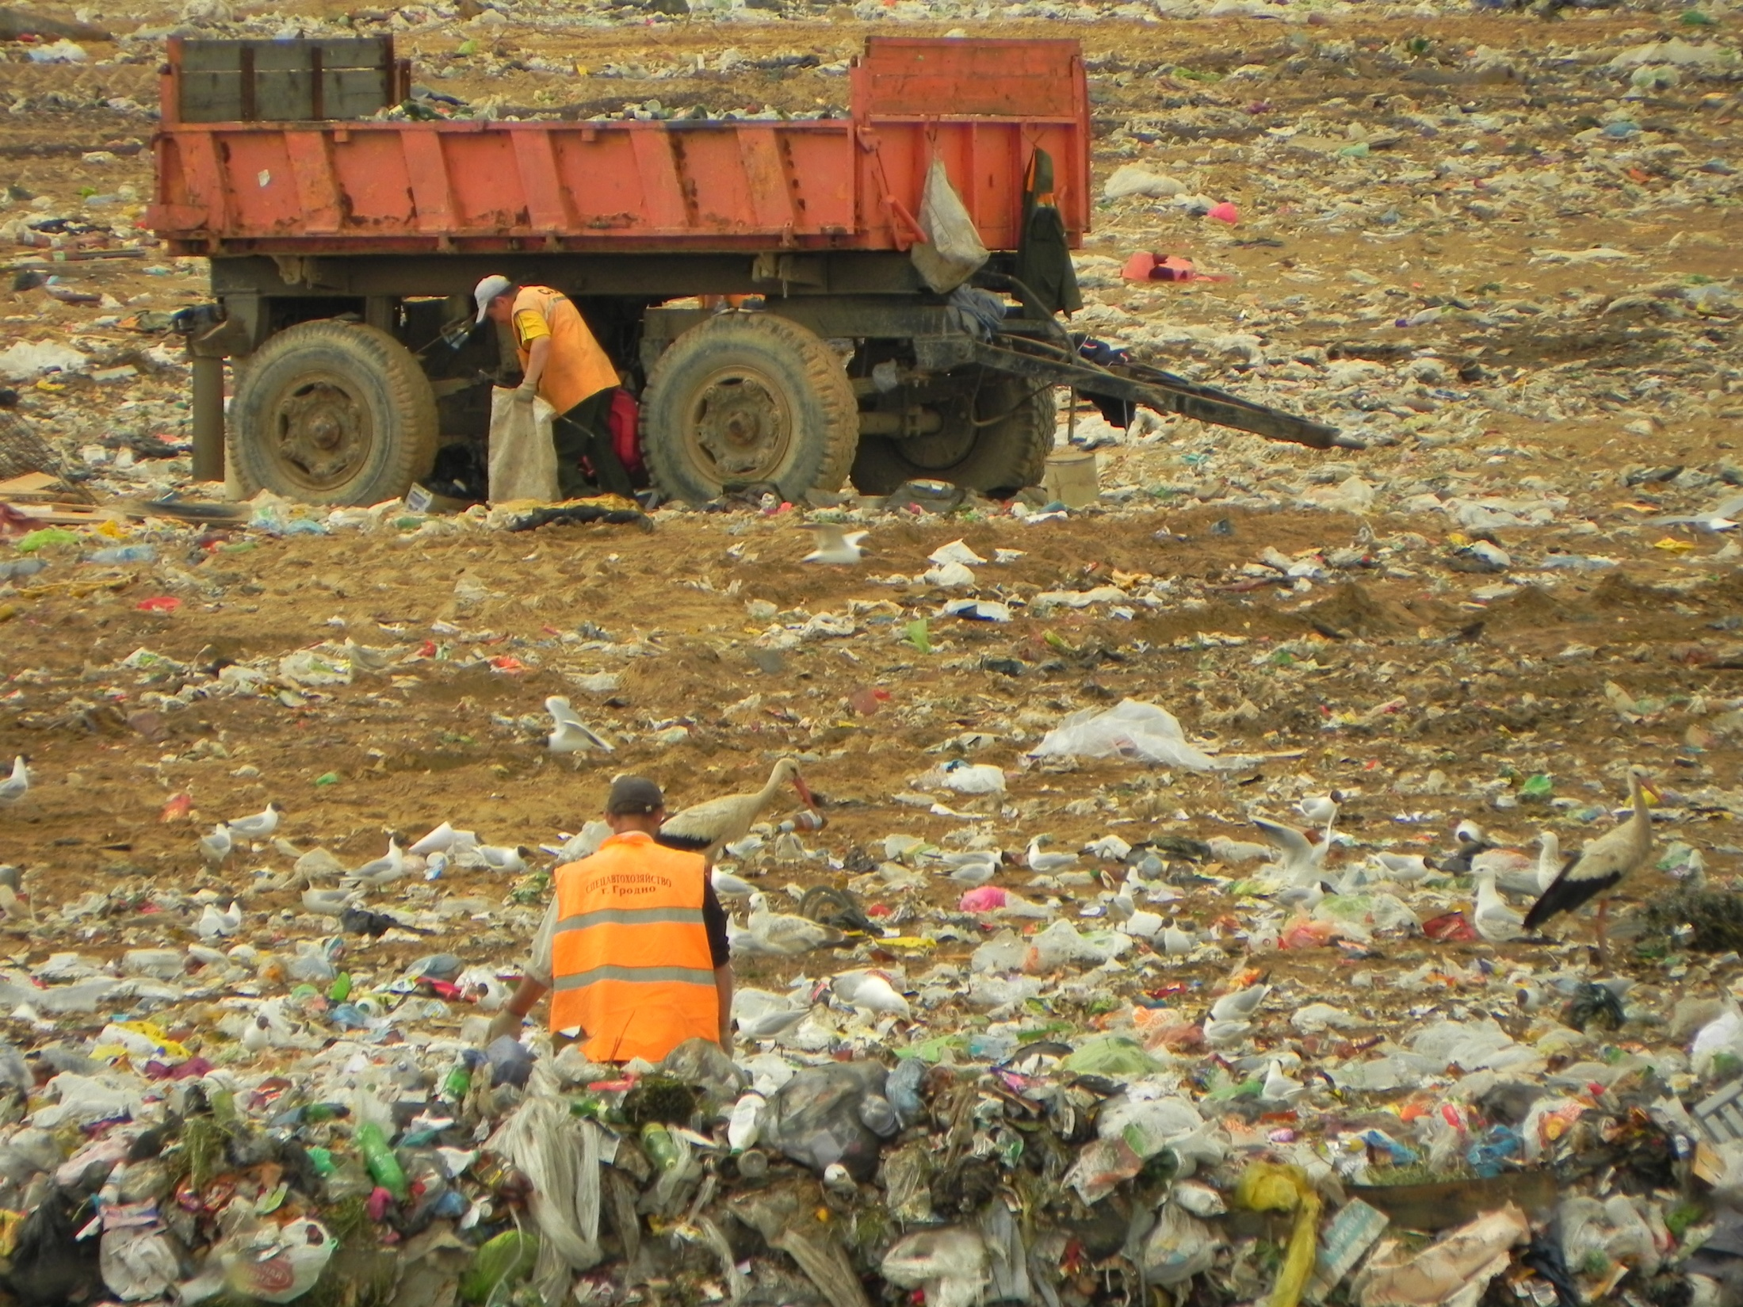

Feeding birds do not afraid people and dogs nearby.

Slide 9
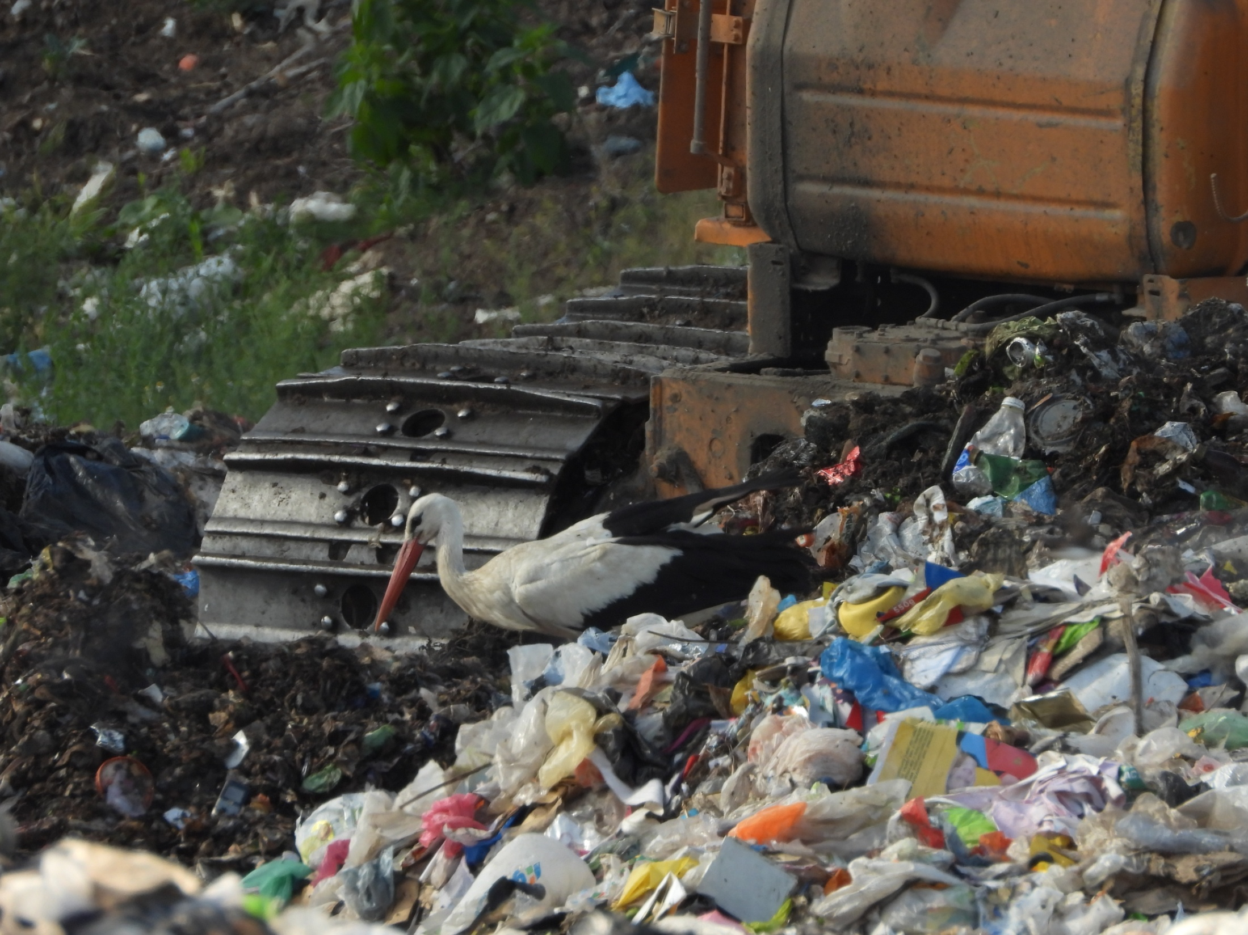
They also do not afraid – and even contrary! –
are attracted by the trucks and excavator as possible source of new food.

Slide 10
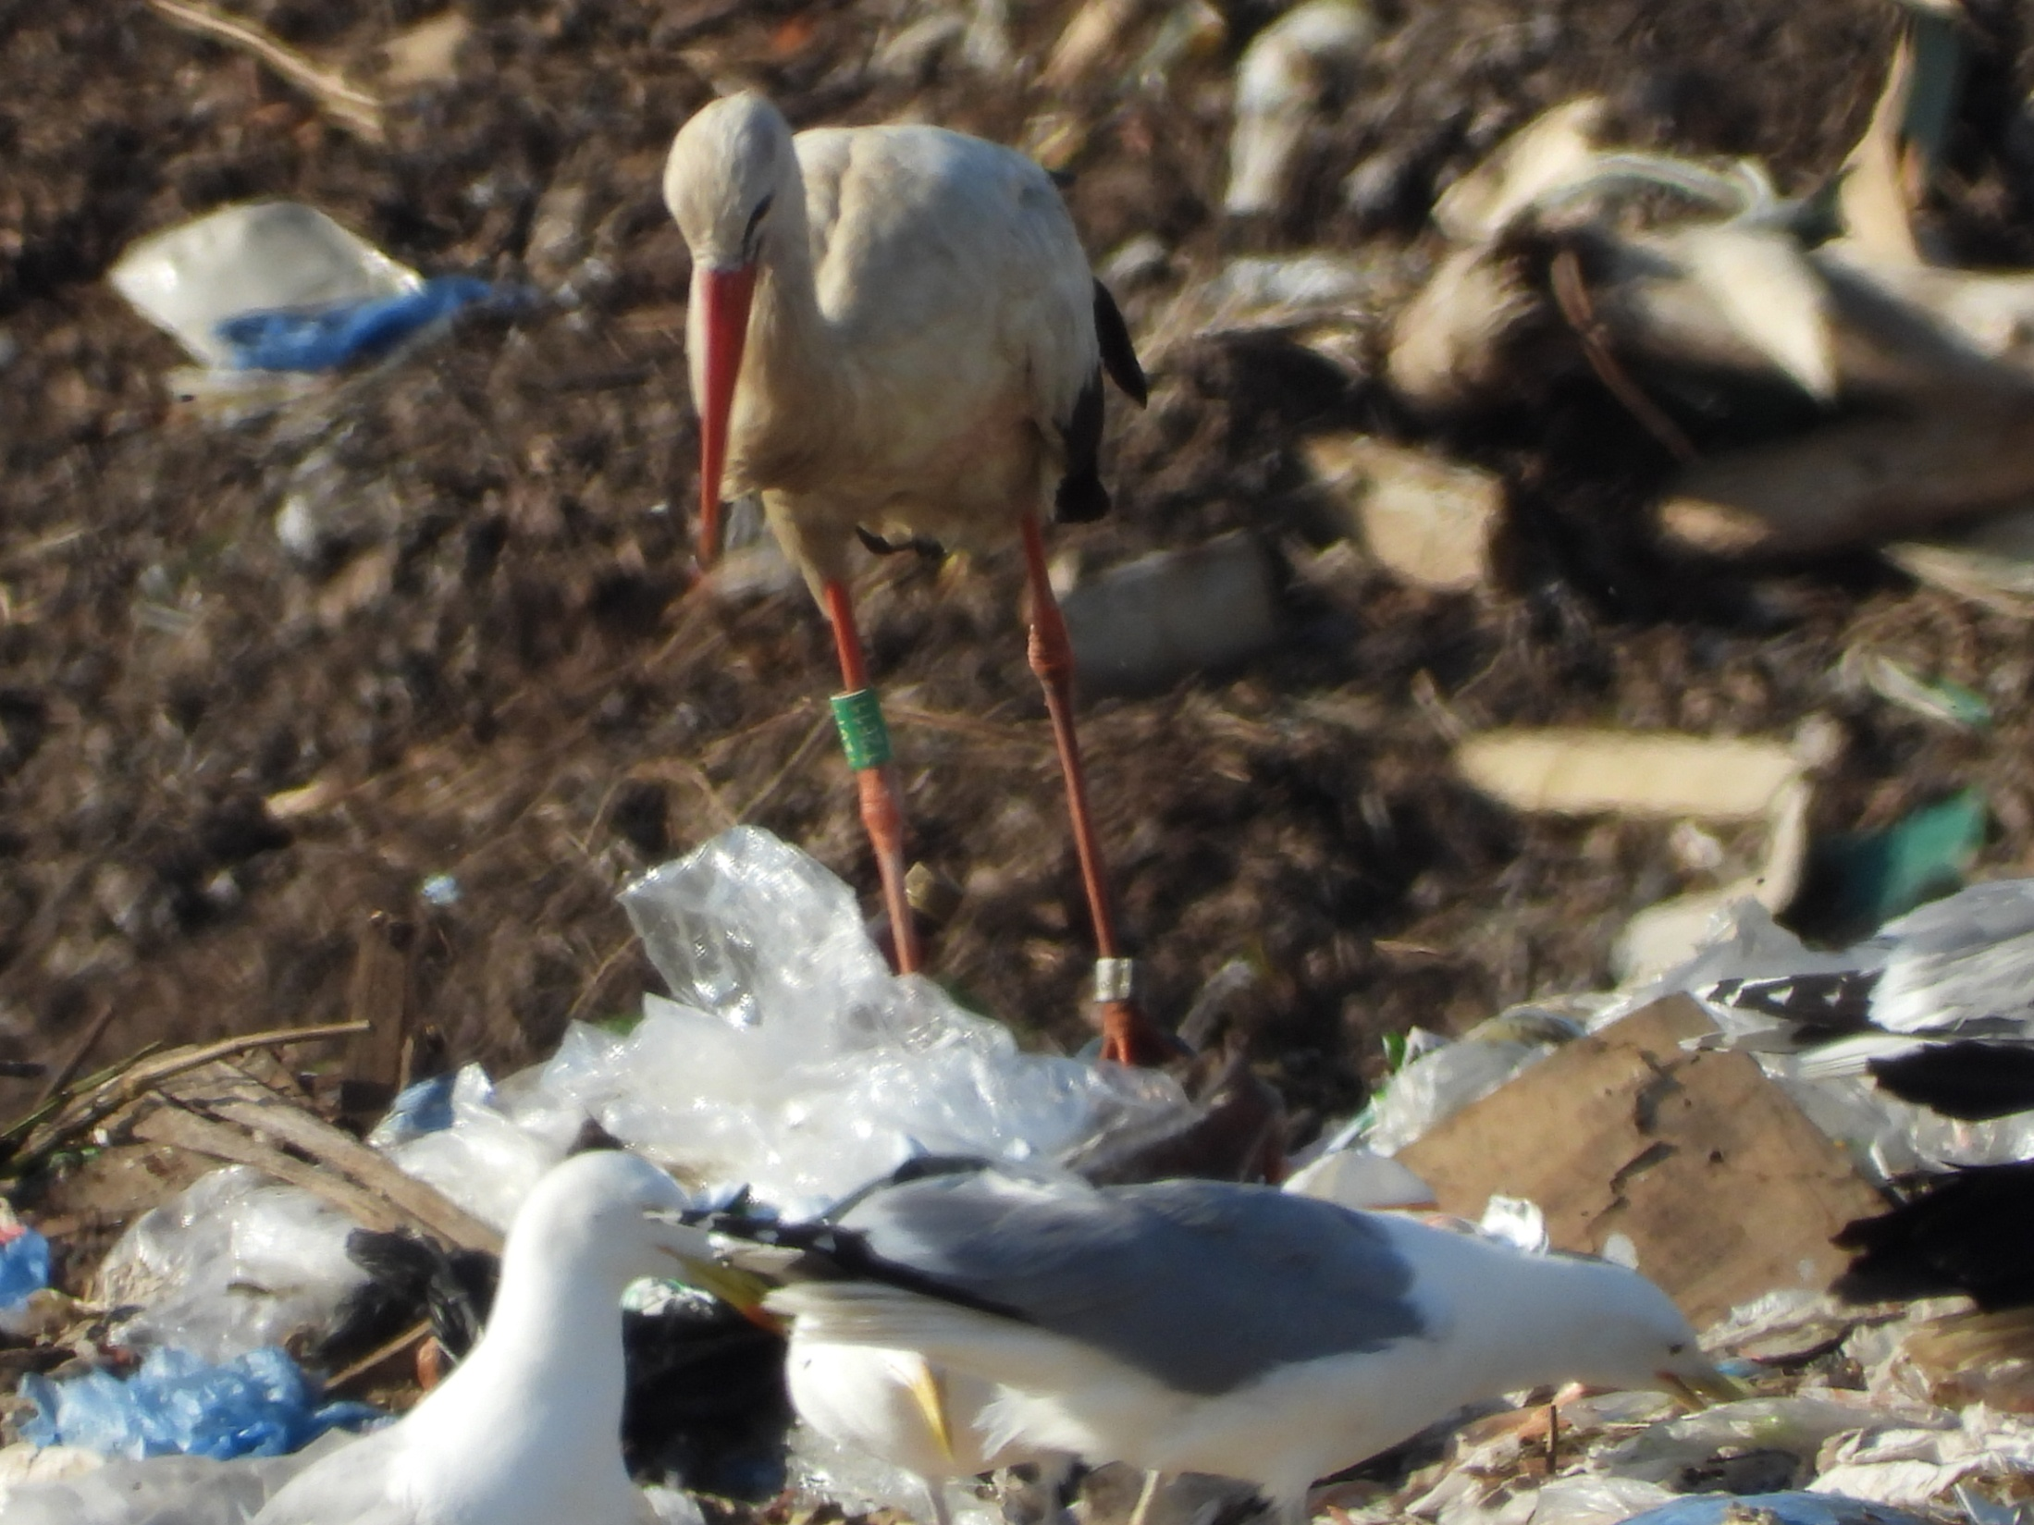
Just a very few birds are ringed (PL, DE)

Slide 11
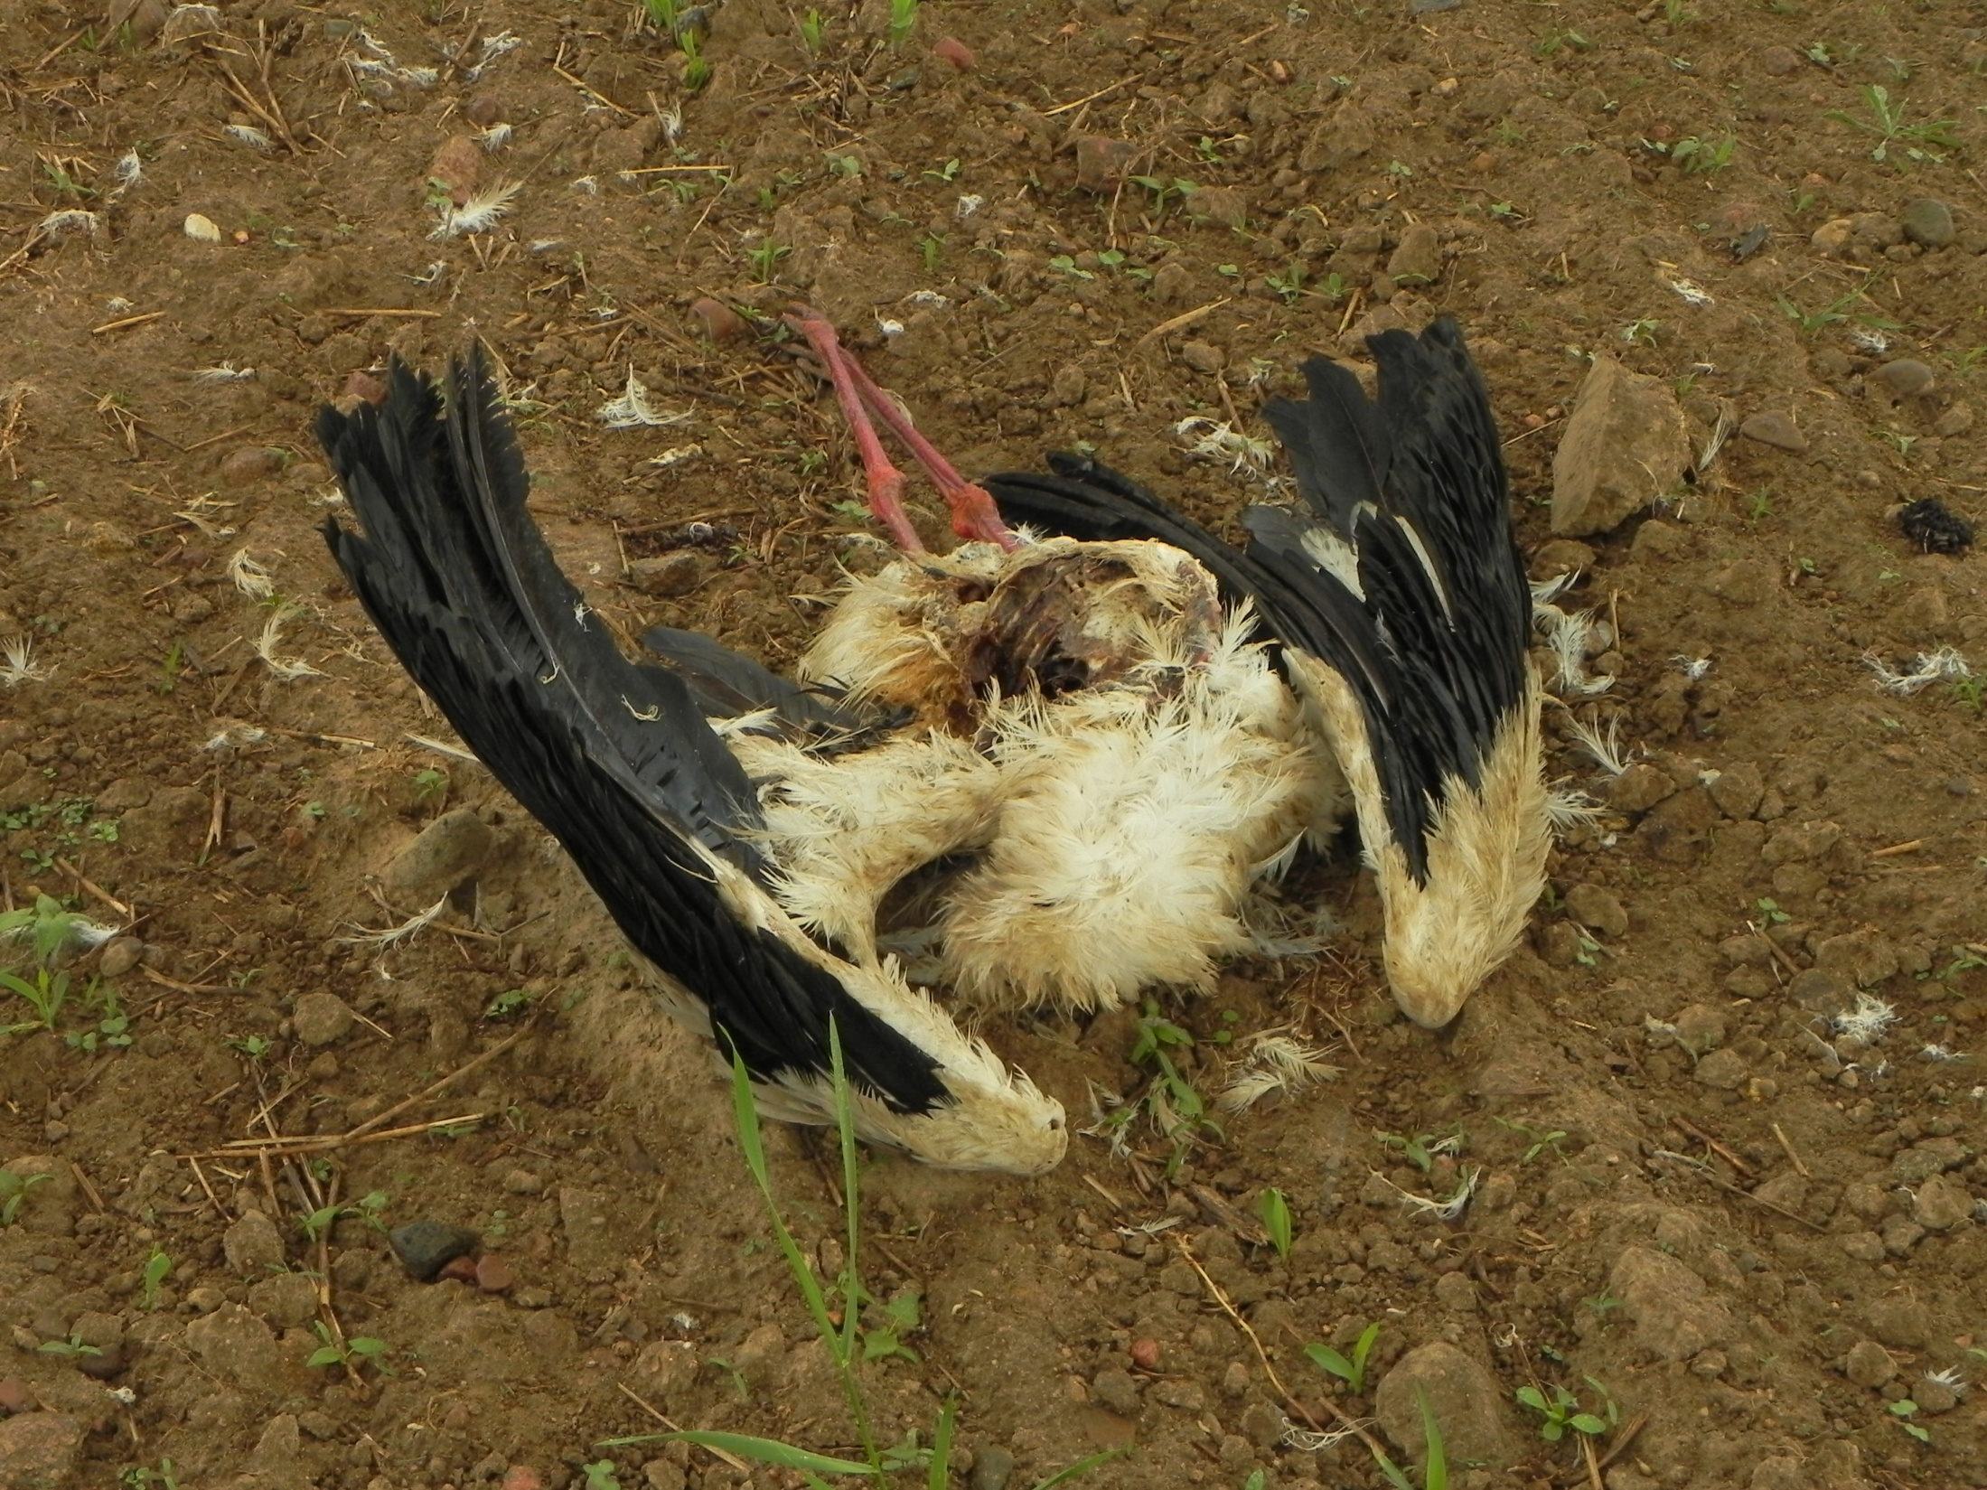
`Dump food` do not looks dangerous for the birds.

Slide 12
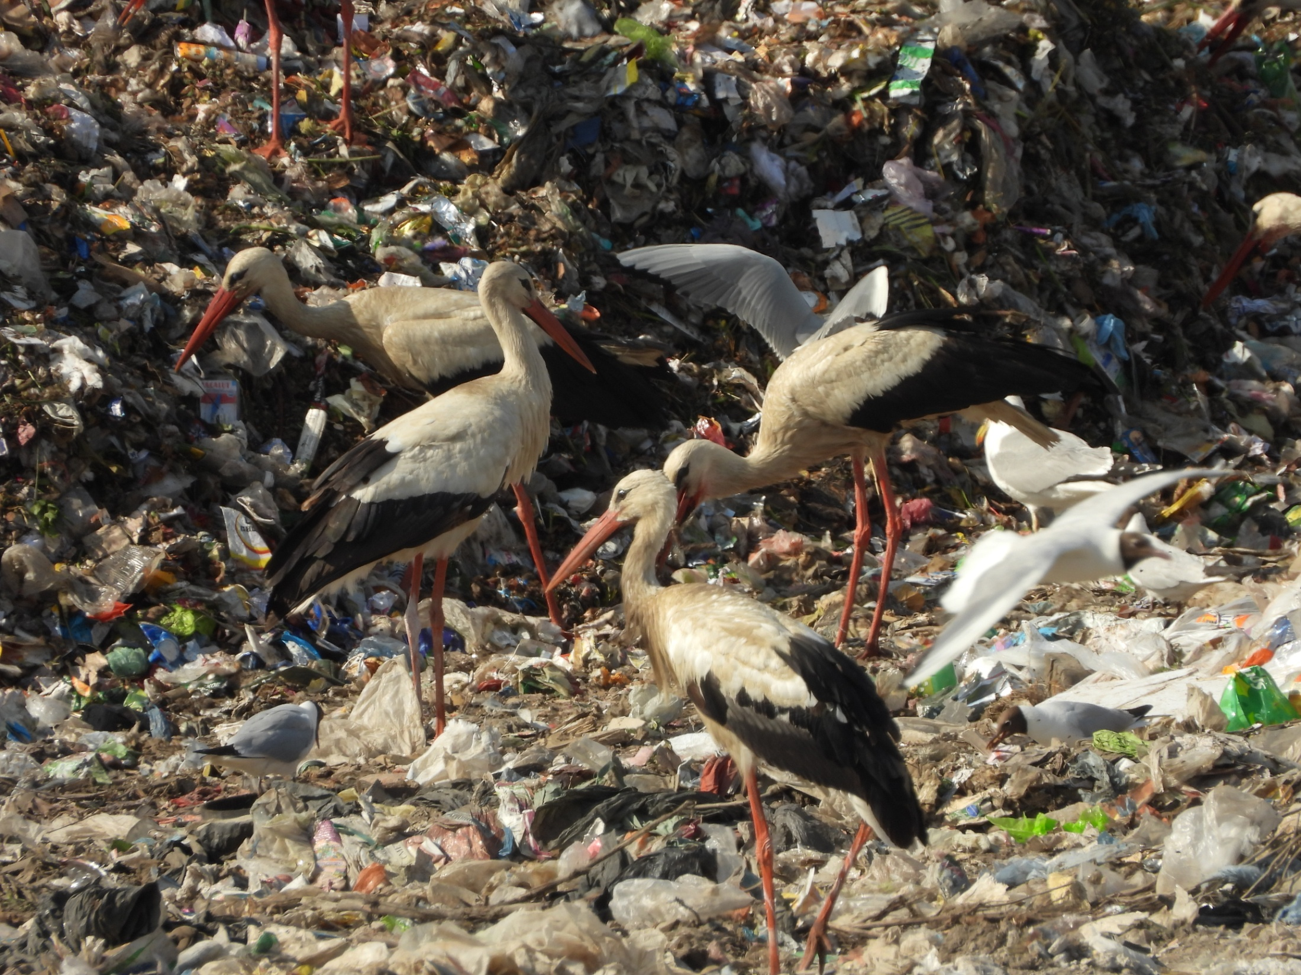
It looks like the activity of feeding depend on nothing except hunger and day time.

Slide 13
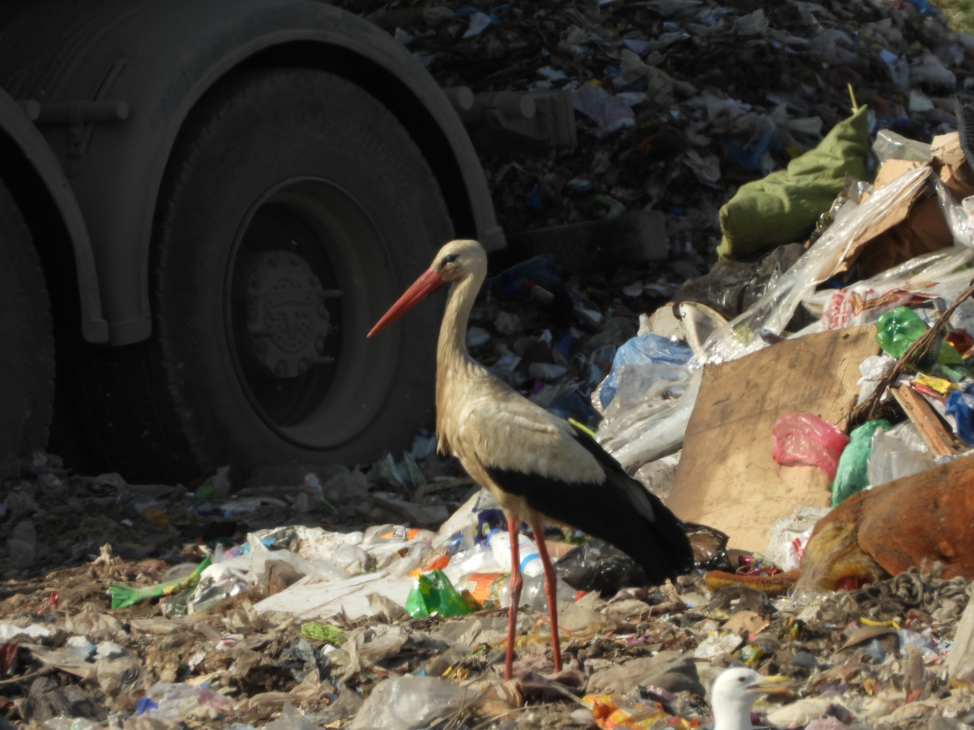
As soon as young birds fledged, they join other on the dump.

Slide 14
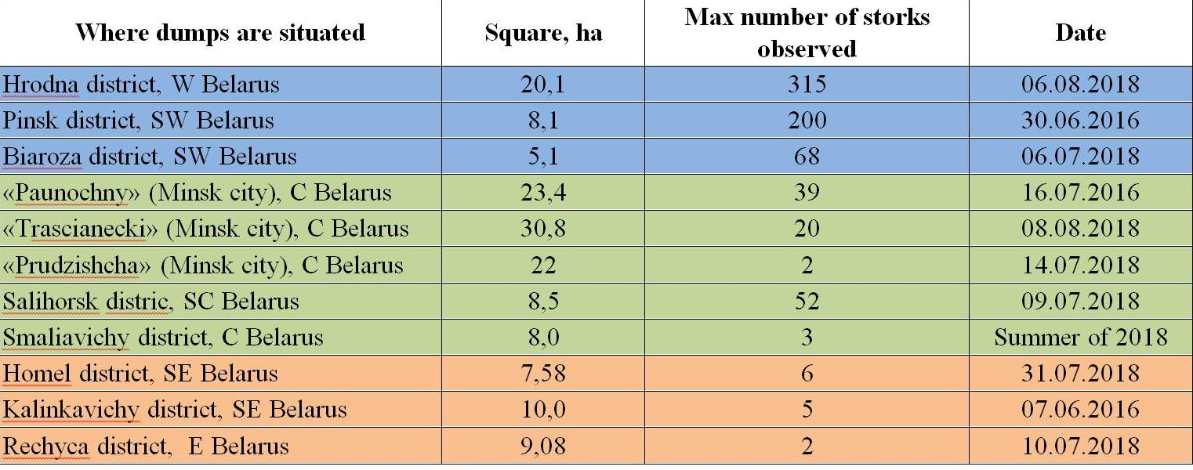
Samusenko et al. 2019
There is still big difference between `West` and `East` of the country on the numbers of storks that using dumps.

Slide 15
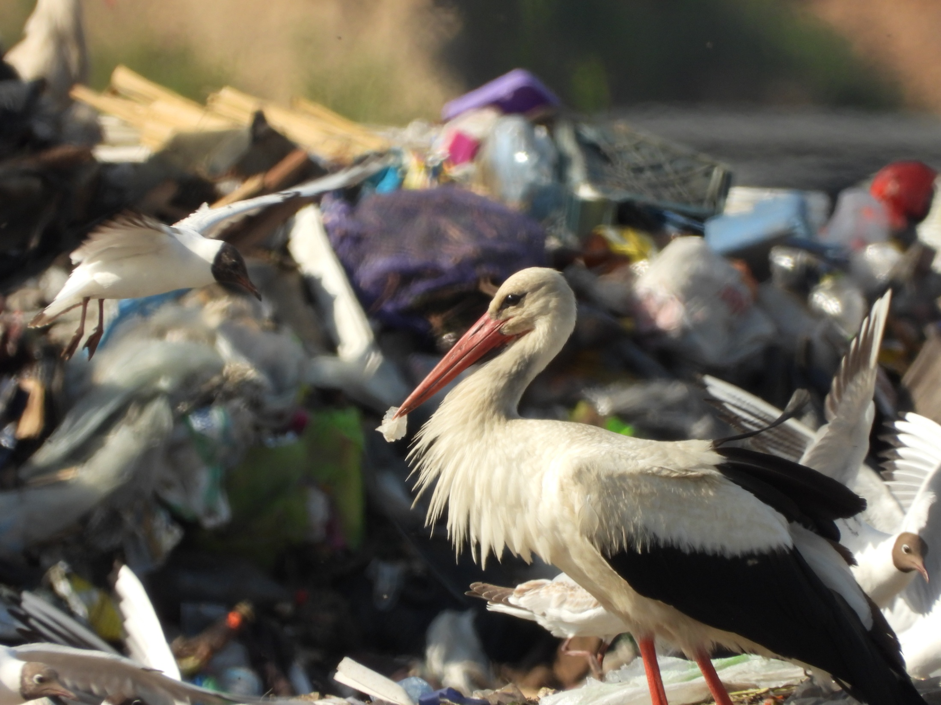
But much more is still unknown!

Slide 16
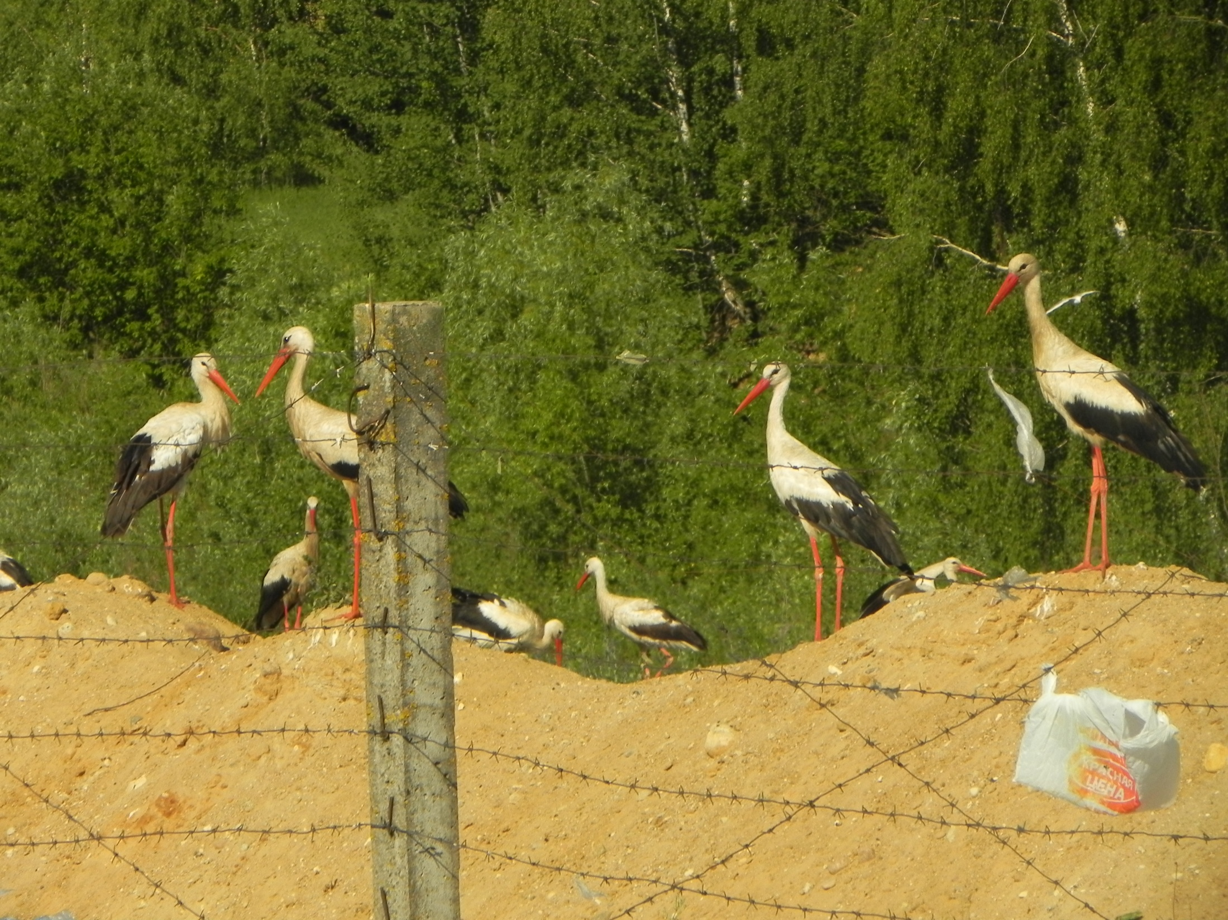
Thank you!

